Slide 1
WeWALK × Google Cloud Integration
Overview of Navigation, Voice Assistant, CV, Analytics, and Cloud Architecture

Slide 2

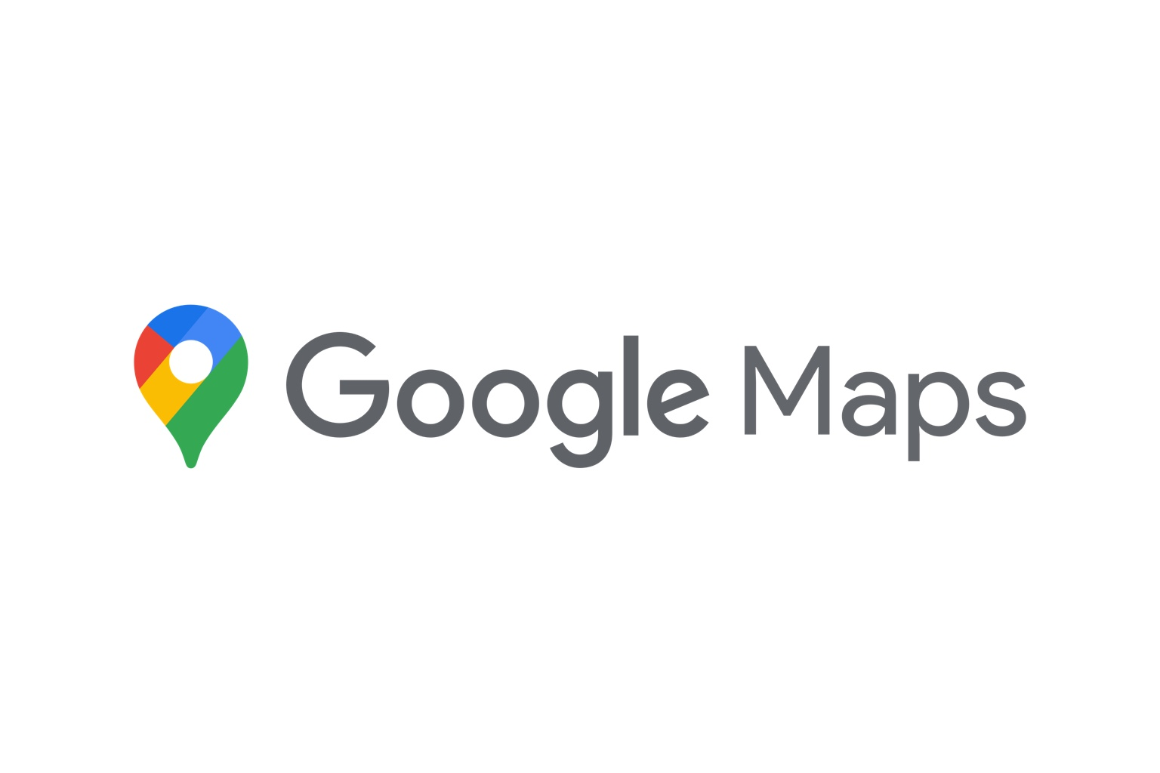




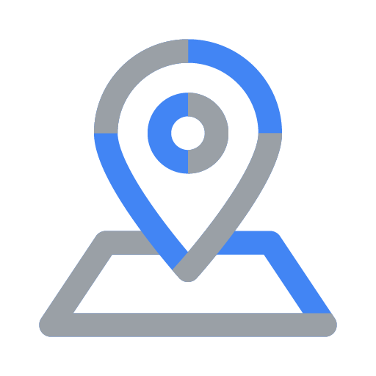

Core Services & Integrations

Slide 3
Multimodal Navigation for Visually Impaired Users
- Step-by-step multimodal navigation
- Works with phone in pocket/bag
- Smart cane interaction first
- Goal: improve sidewalk & crosswalk detection

Slide 4
Smart Cane Voice Assistant (Current & Beta)
- Runs on Vertex AI Agent Engine
- Uses Gemini 2.5 Flash/Pro
- Developed via Google ADK
- Future: offline on-device voice models

Slide 5
Situational Awareness & Computer Vision
- Object detection & finding
- Door/entrance detection for last-mile problems
- Room layout & object understanding
- Clothing recognition

Slide 6
Mobility Analytics & Training Insights
- Cane angle & movement tracking
- Swipe detection
- Obstacle interaction logs
- AIM training platform data

Slide 7
Backend & Operations on Google Cloud
- Cloud Run, Cloud SQL, Firestore
- Cloud Logging, Monitoring, Artifact Registry
- Recent migration from AWS to Google Cloud (credit-supported)

